Slide 1

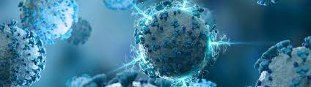
Dr.. Maged Askar
Sciientiiffiic data management

Slide 2

Team Members
1- أروي مصطفي كمال عبدالوهاب
2- سهيلة عصام الدين محمد
3-امنية طارق فرغلي محمد
4-افنان عيد محمود

Slide 3


Experiment type:
Number of Records:
Number of Column:
Expression profiling by high throughput sequencing.
27470
14 col
ARCaP1 ARCaP2 ARCaP3 ARCaP4
ARCaP tw1 ARCaP tw2 ARCaP tw3 ARCaP tw4
Samples:
4 Sample
Control:
4 Sample
Treat:

Slide 4
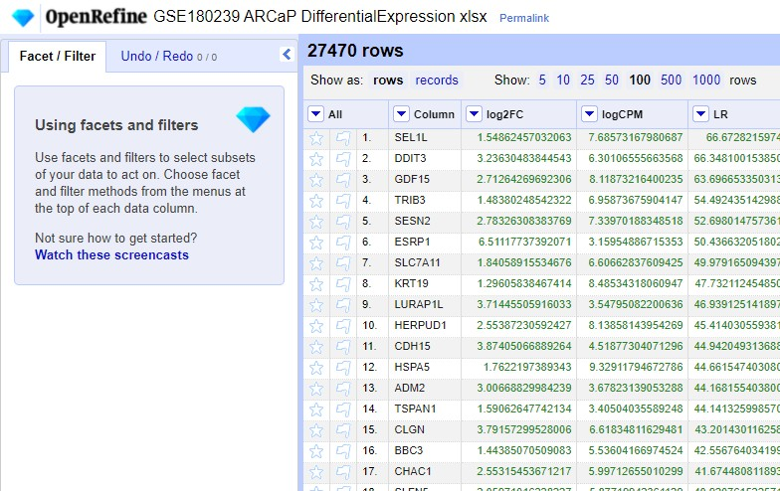
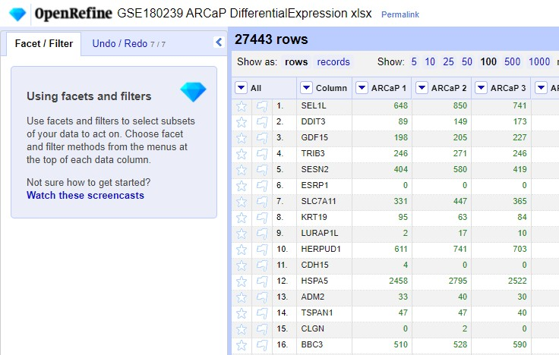
The Data Before Cleaning Is 27470 Records.
The Dtaa After Cleaning Is 27443 Records.

Slide 5
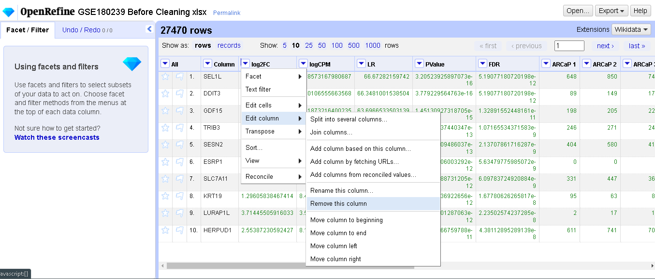
Cleaning With OpenRefine

Slide 6
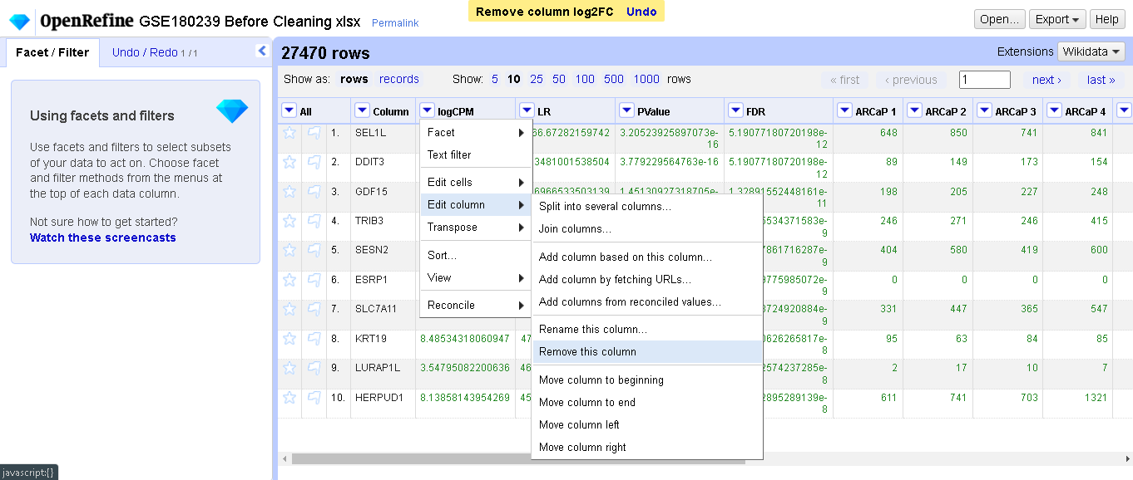
Cleaning With OpenRefine

Slide 7
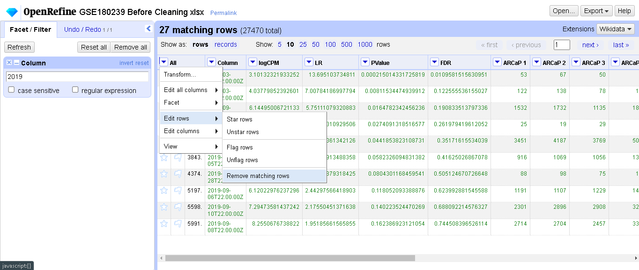

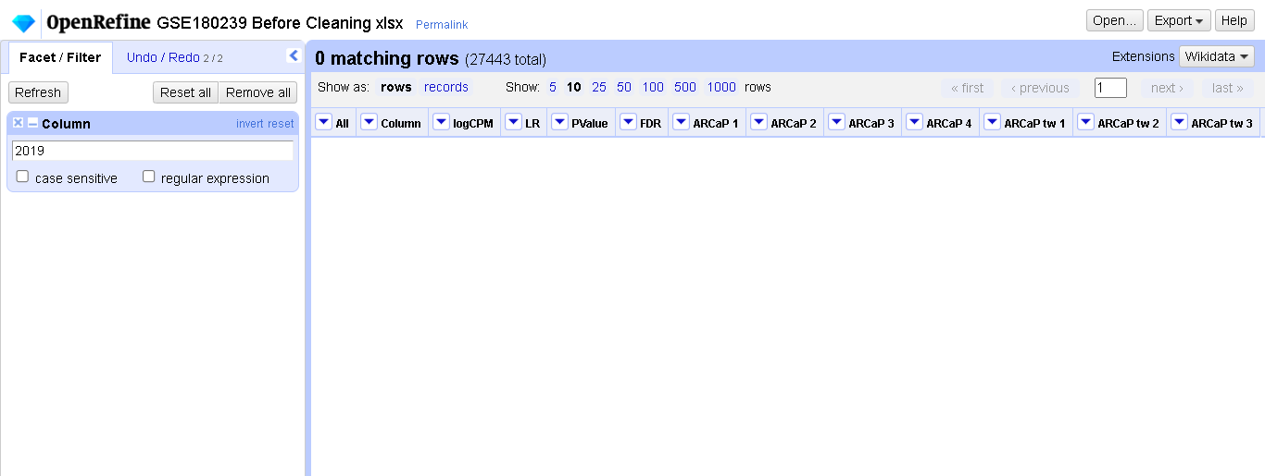

Slide 8
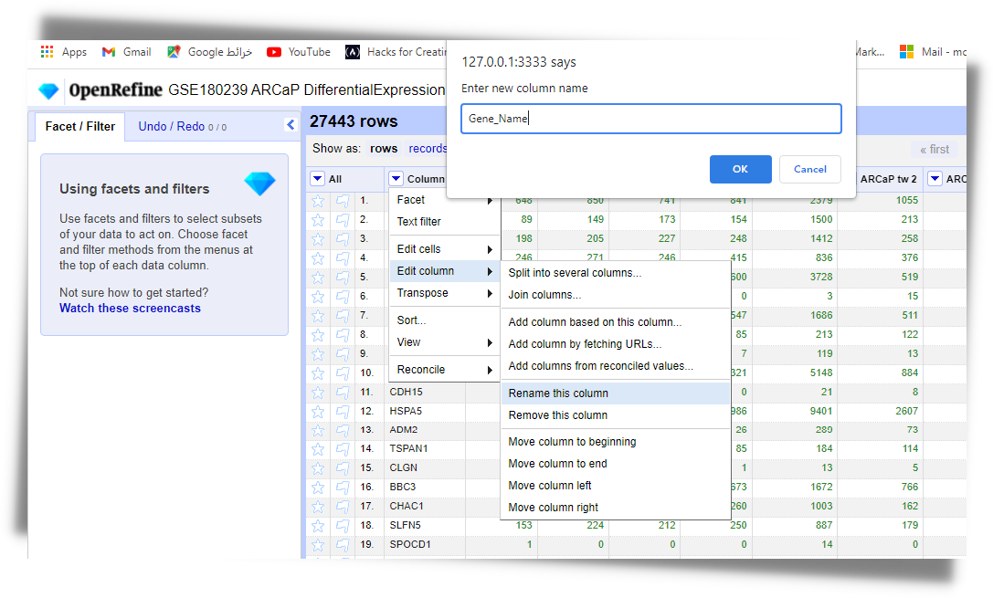
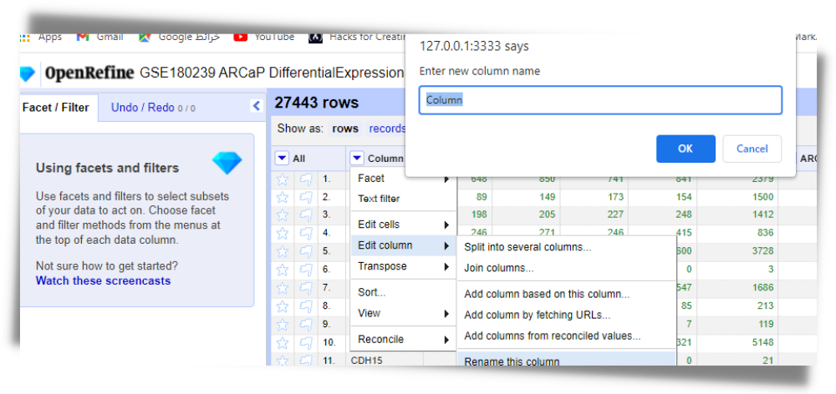

Slide 9
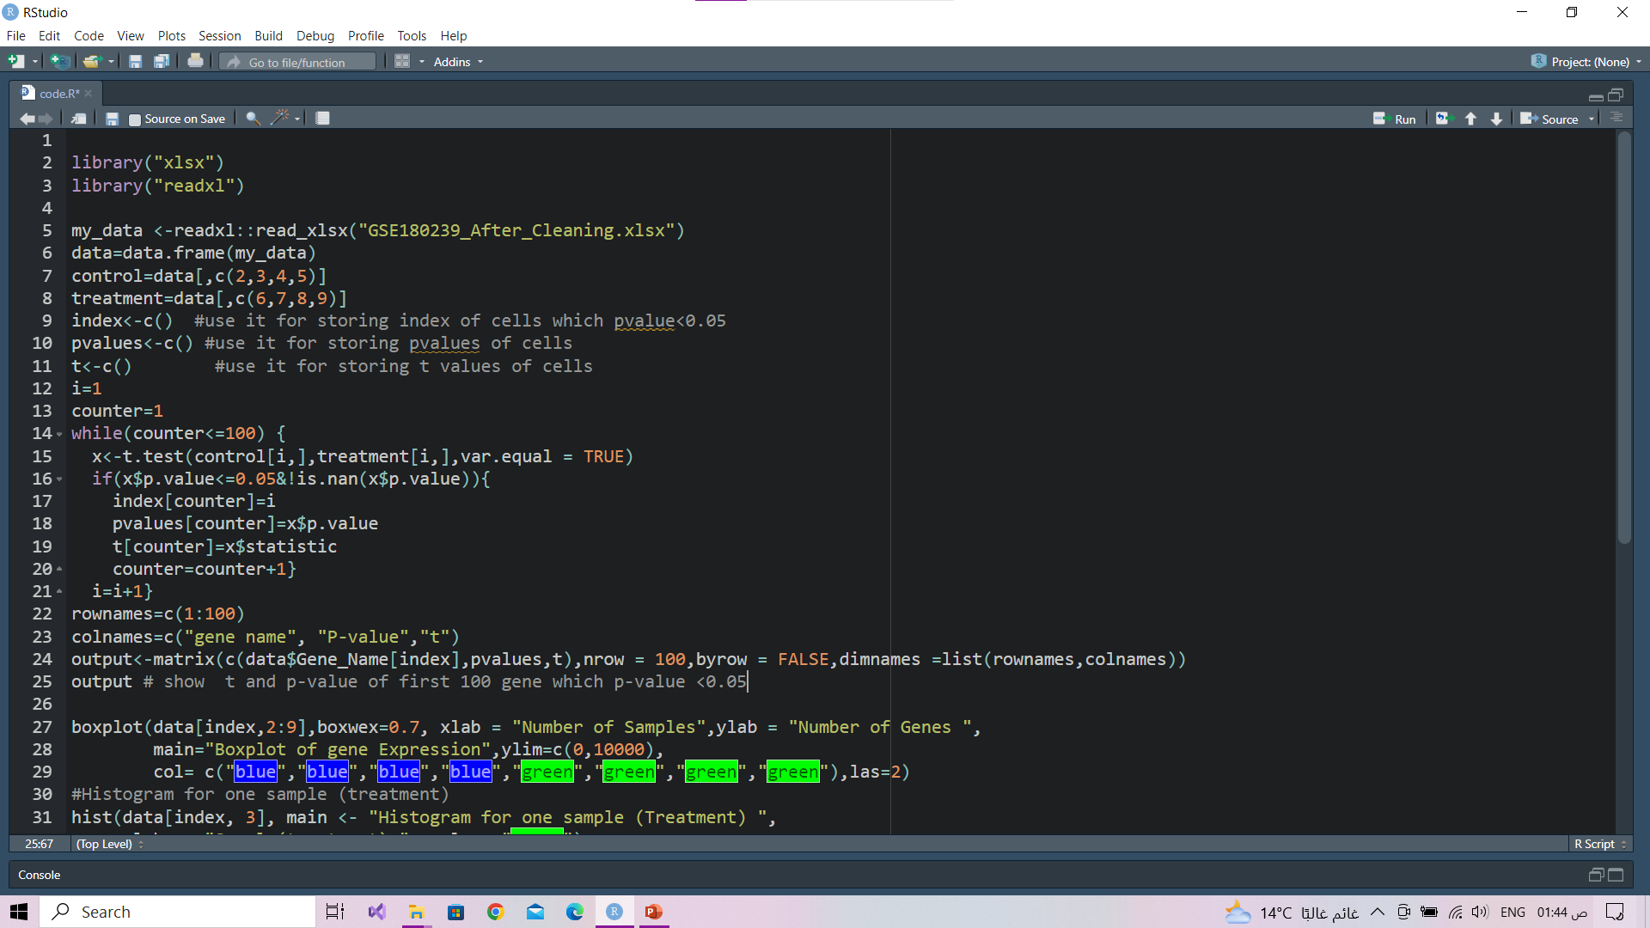


Slide 10
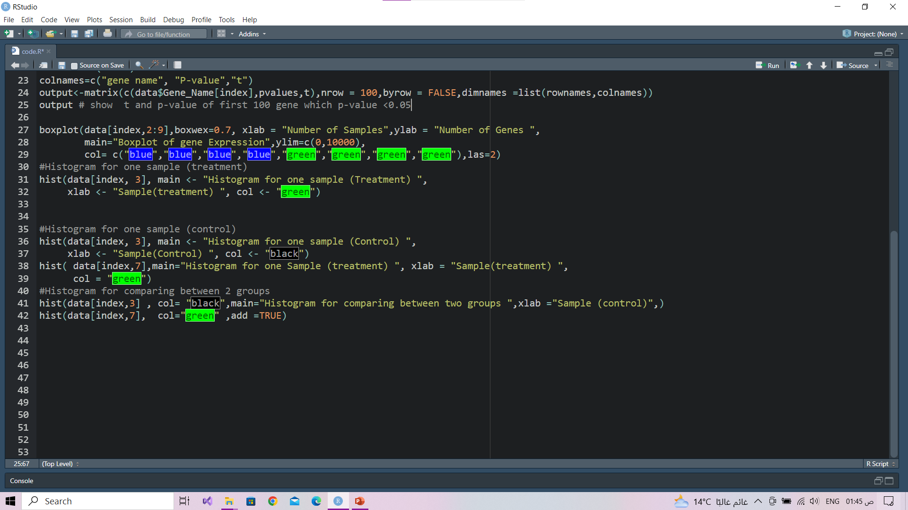

Slide 11
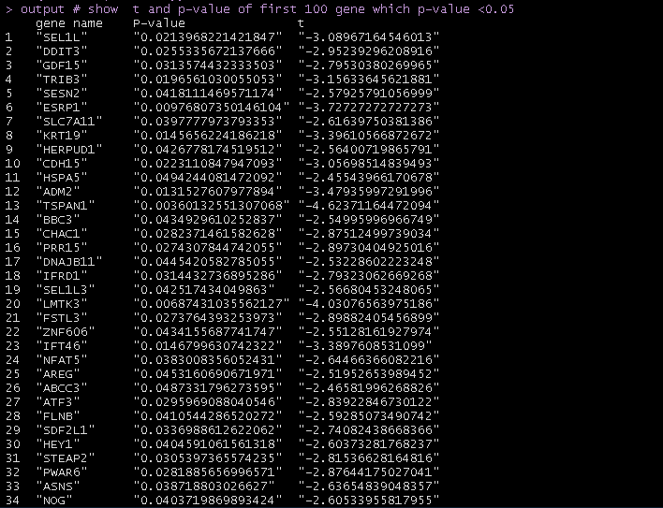
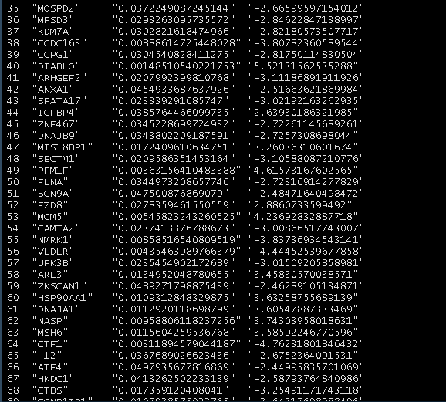
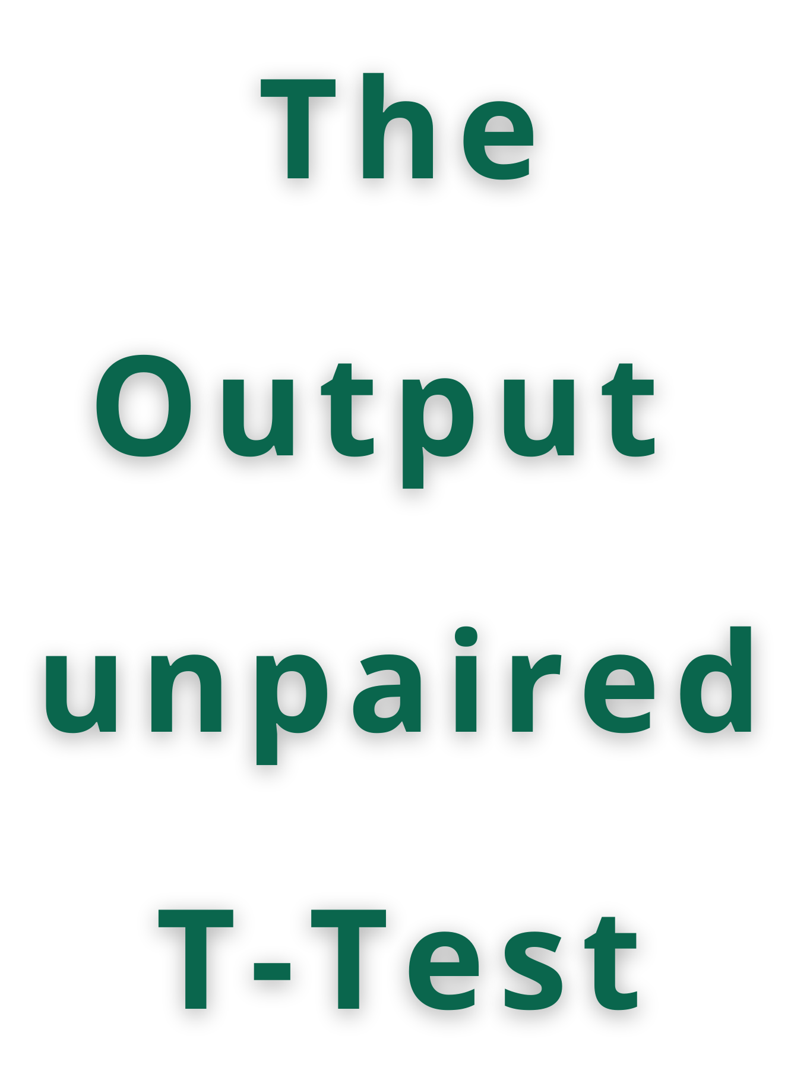

Slide 12
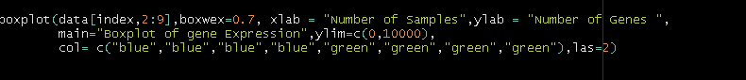
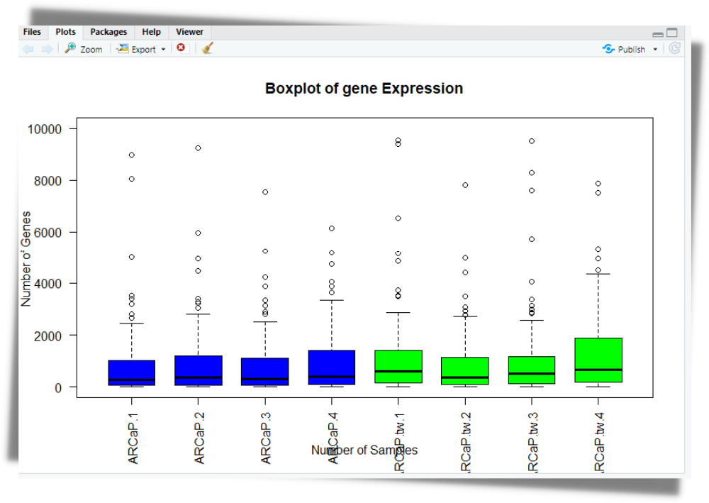
Why we Use Boxplot?
show distribution of numeric data value
compare between multiple group provide
high level information
set limitations on the density of data that it can show

Slide 13
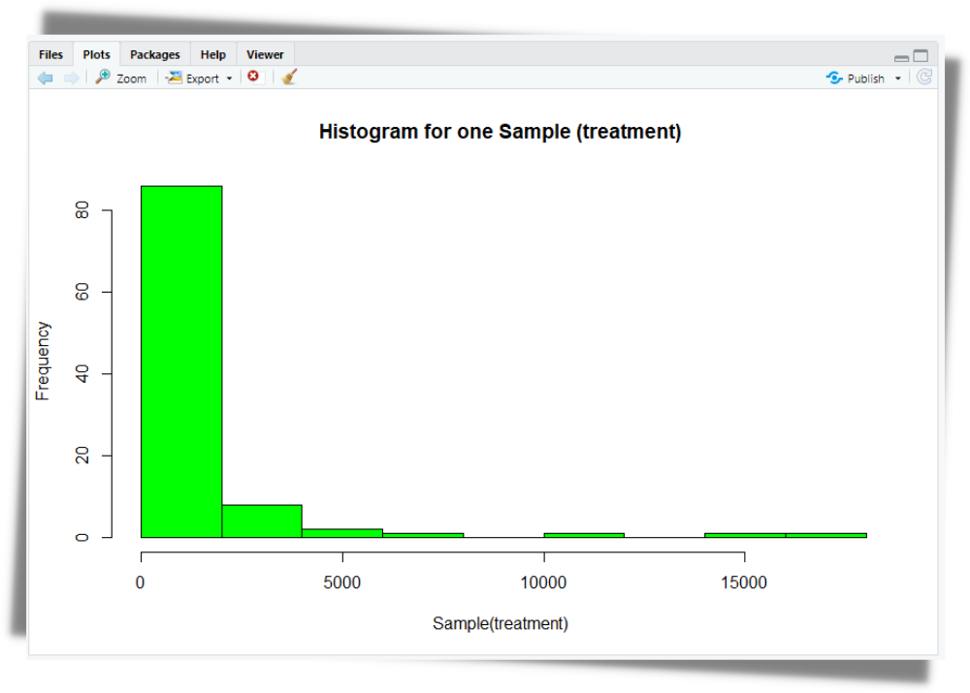
Why we Use Histogram?
Use a zero valued baseline
Choose an appropriate number of bins
Choose interpretable bin boundaries
The data are numerical

Slide 14
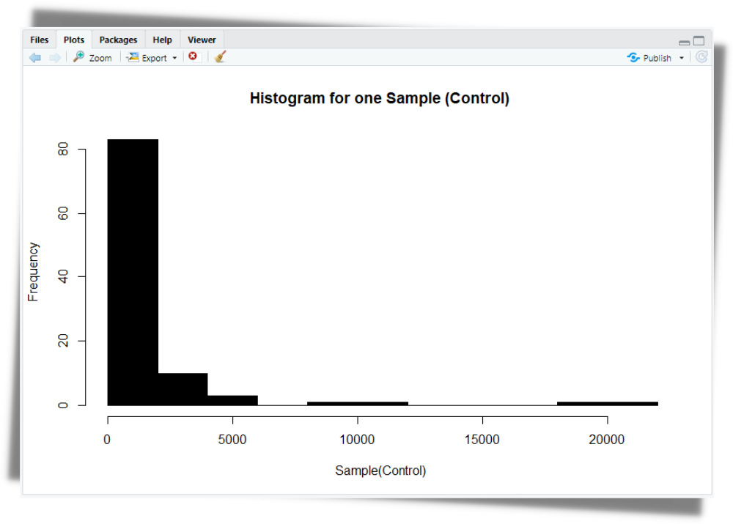

Slide 15
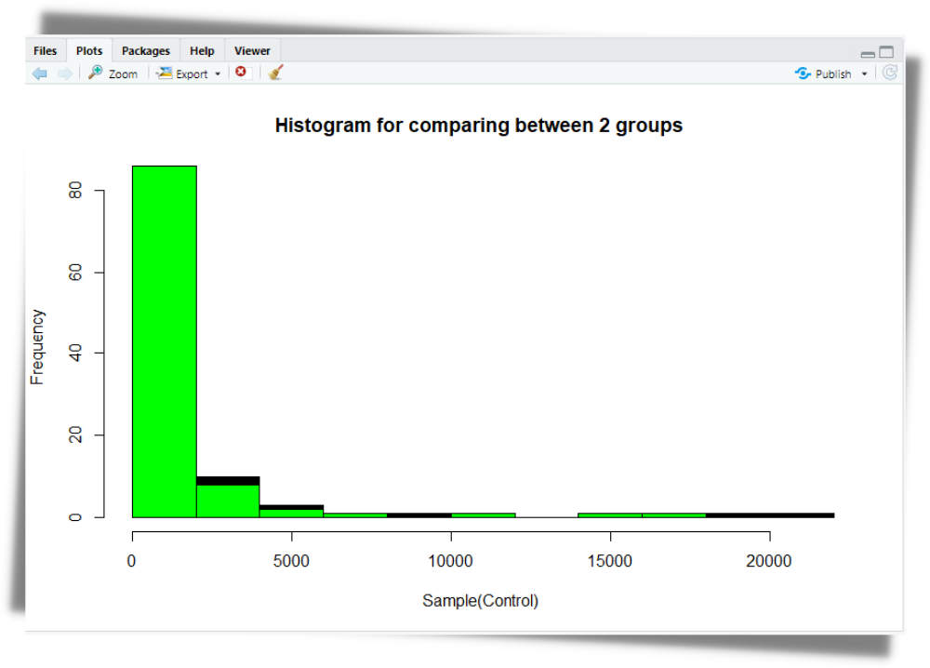

Slide 16
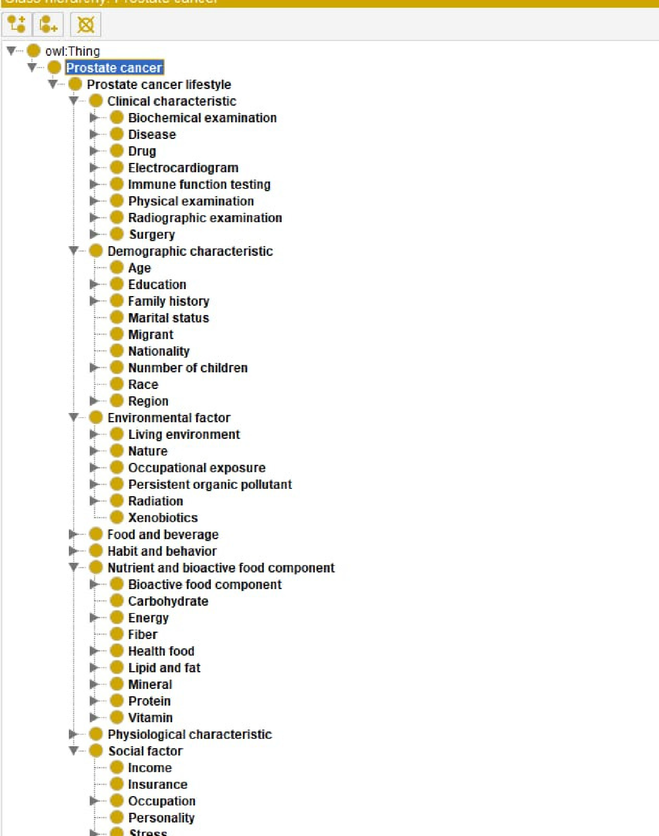

From:: BiioPorrttall
NCBI

Slide 17
What did we need exactly in the semantic data intgration phase?
in the query making stage we need more data property and object property in individuals
Such as:
data property(aim of treatment-description-taken_by) in individual(warfarin) data property(waist_size-how_to_measure_it) in individual(visceral_fat)
data property(symptoms_or_conditions-causes) in individual(testosterone) data property(definition) in individual(prostate_specific_antigen)
data property(effects_on_the_body) in individual(oxidative_stress)
data property(problems_with_leptin-how_leptin_controlled) in individual(lepton) data property(molar_mass-formula-code) in individual(glutathione)
data property(biological_target-code-formula-normal_range-use) in individual(vitamins)
then we collect this data from different websites and we integrate it with existing data
then we expressed this integration with ontology.

Slide 18
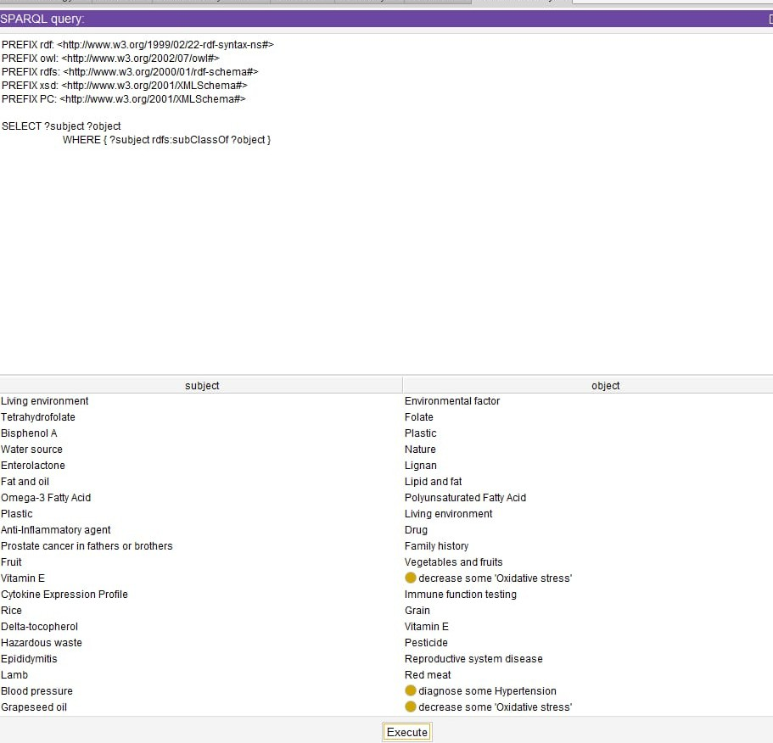
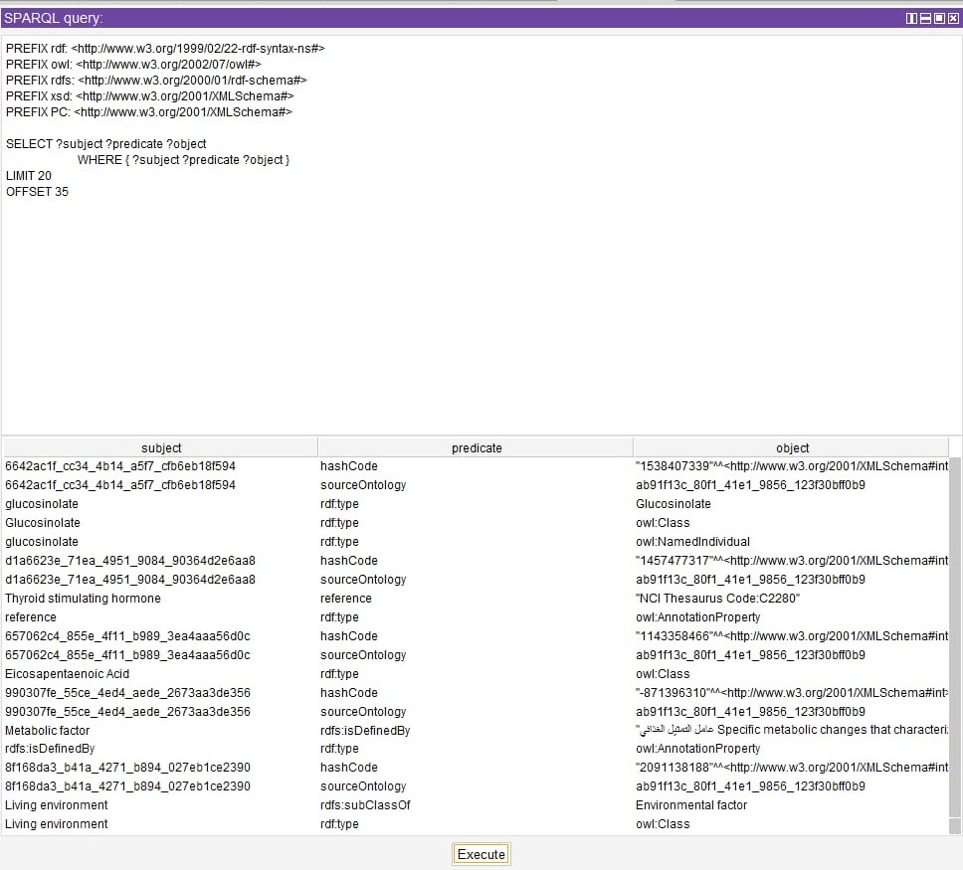


Slide 19
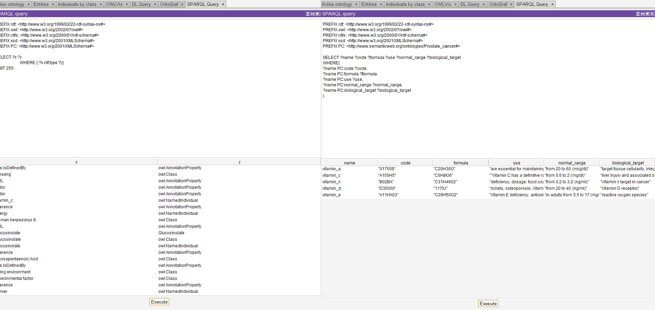


Slide 20
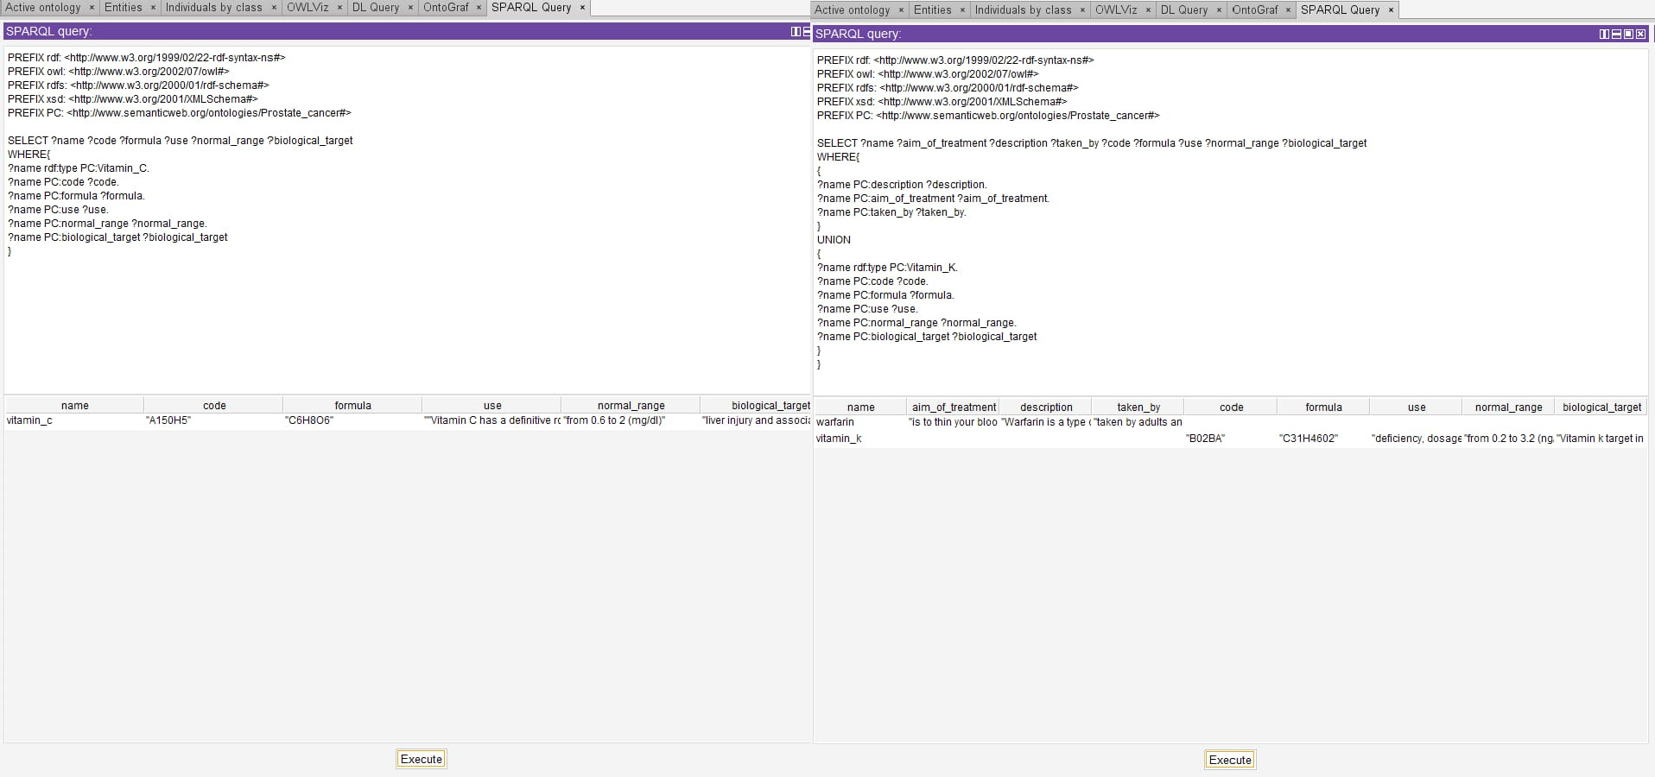

Slide 21
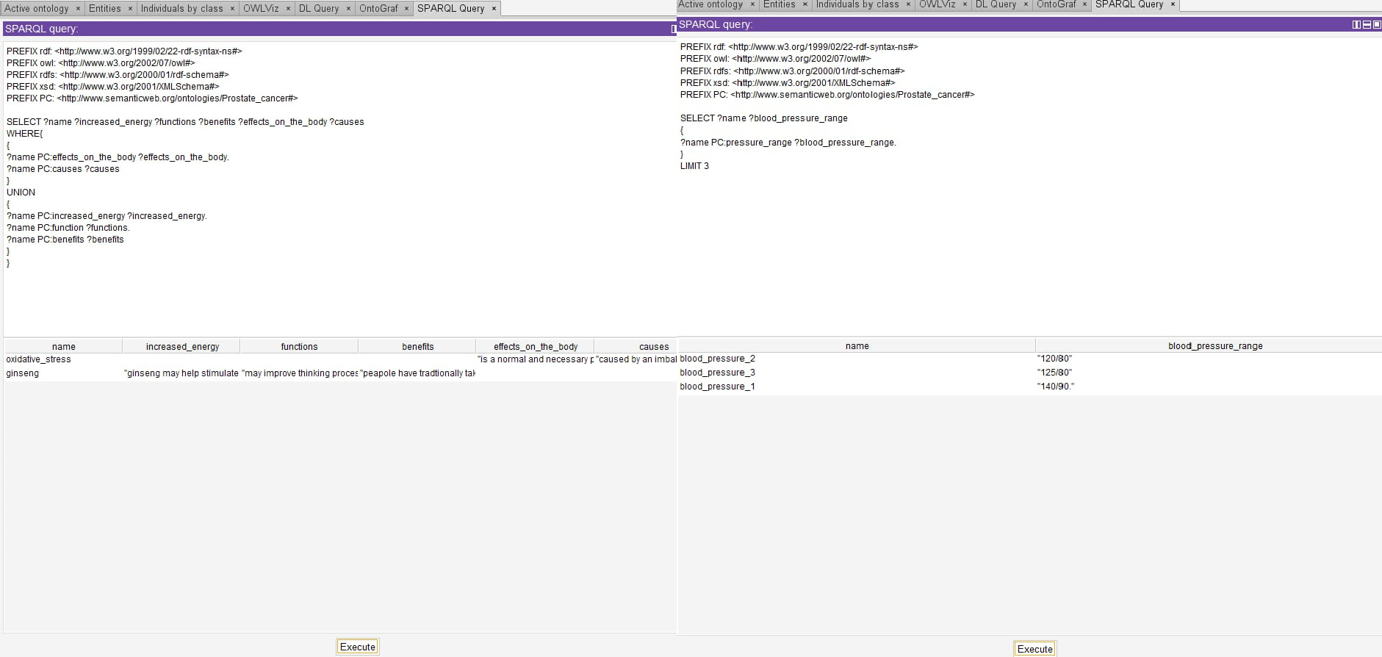


Slide 22
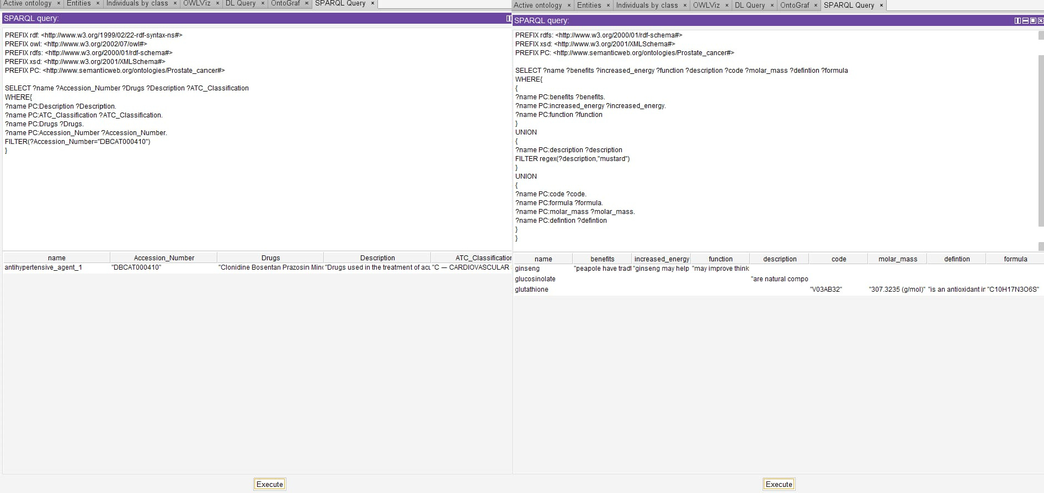


Slide 23
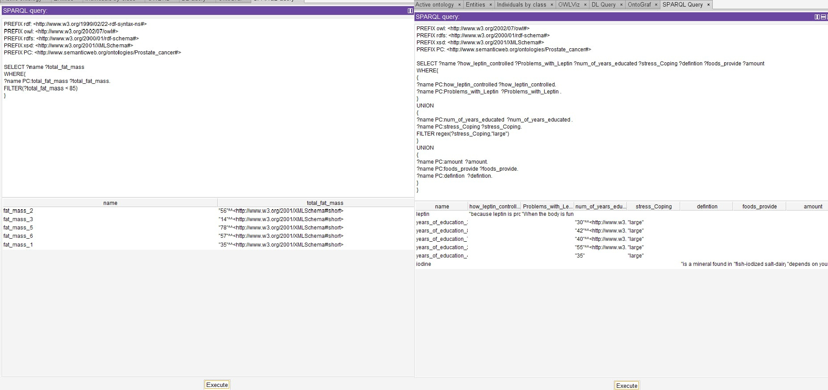


Slide 24
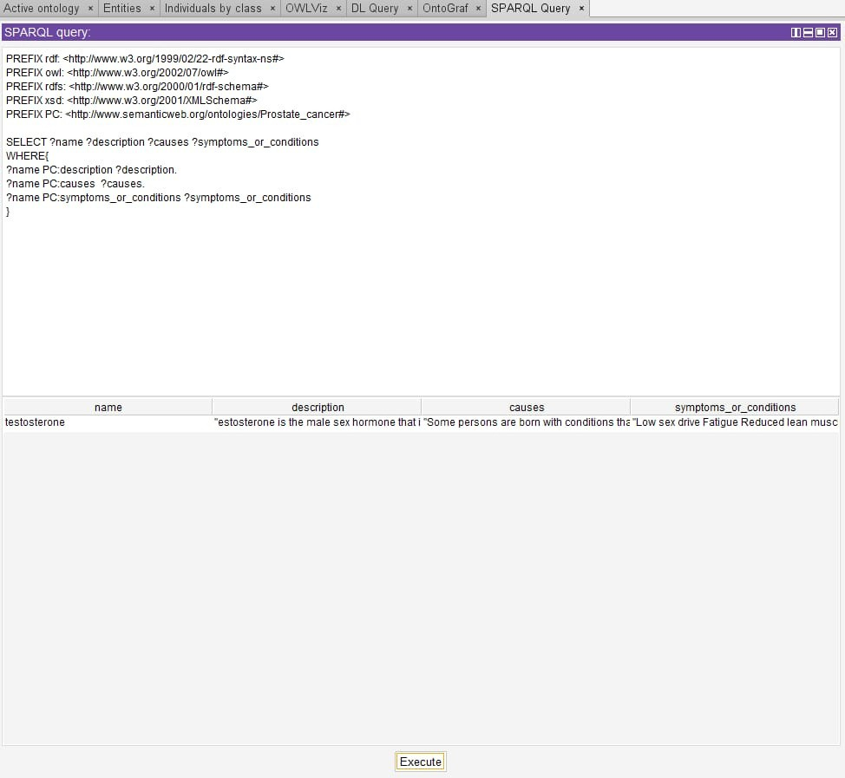

Slide 25
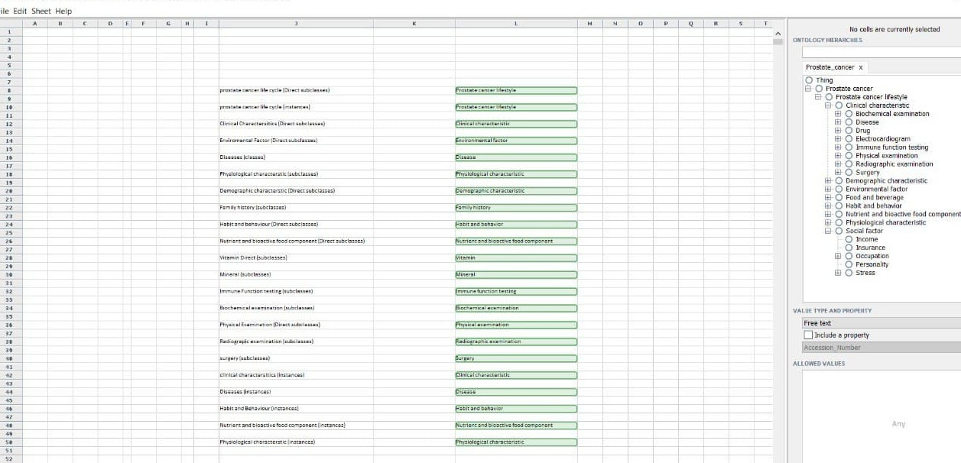
Right Field Tool

Slide 26
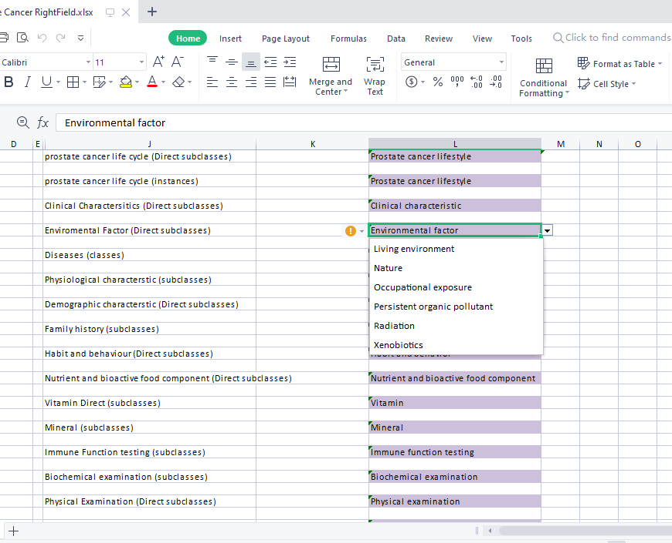
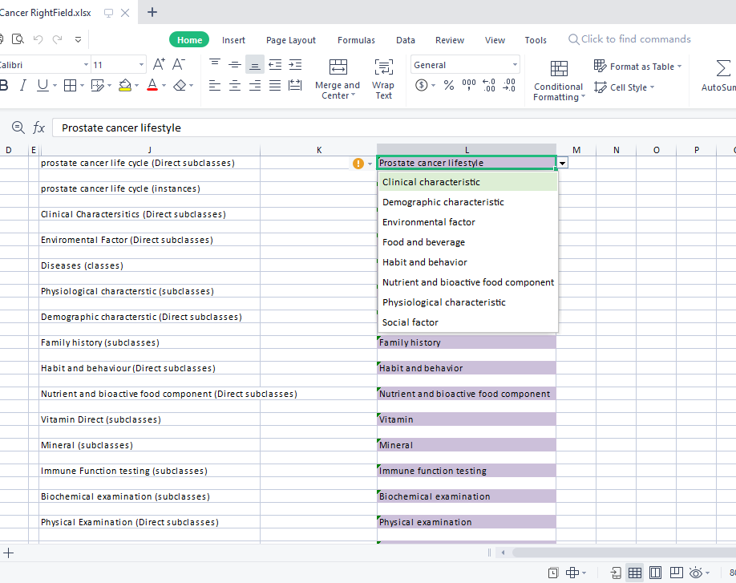

Prostate cancer lifestyle
Environmental factor

Slide 27
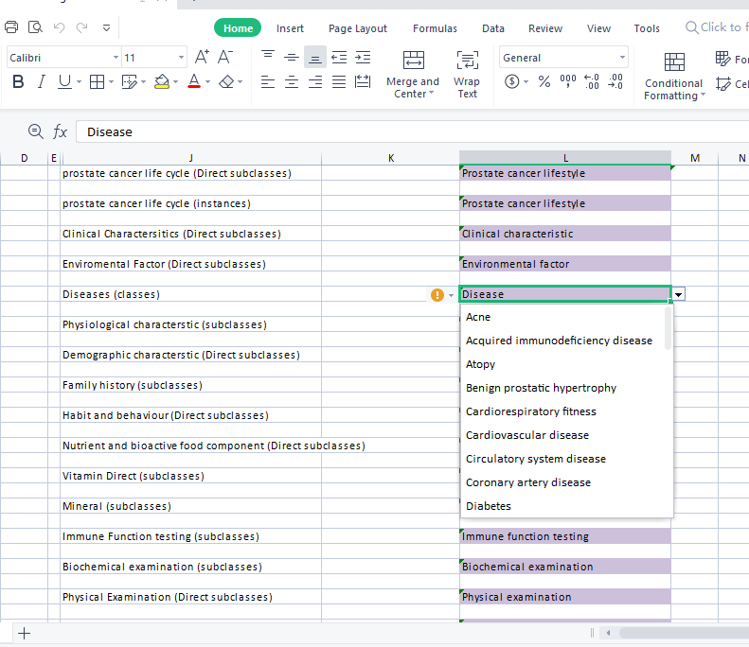
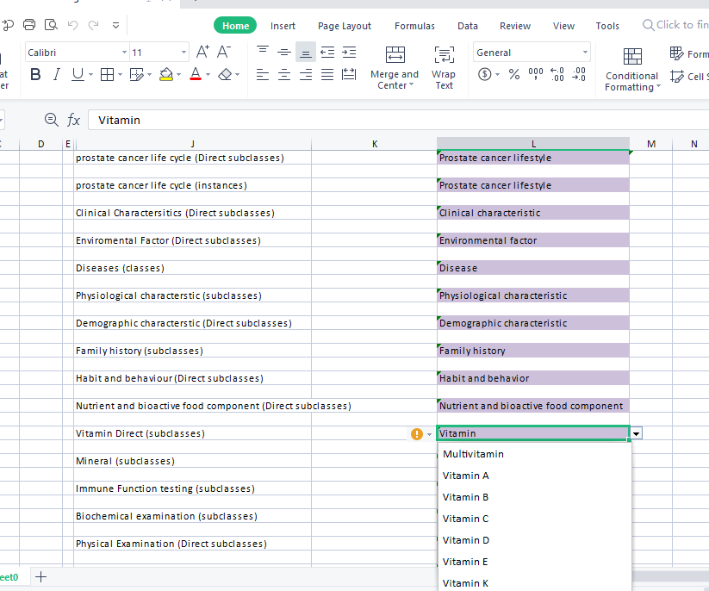
Disease
Vitamin

Slide 28
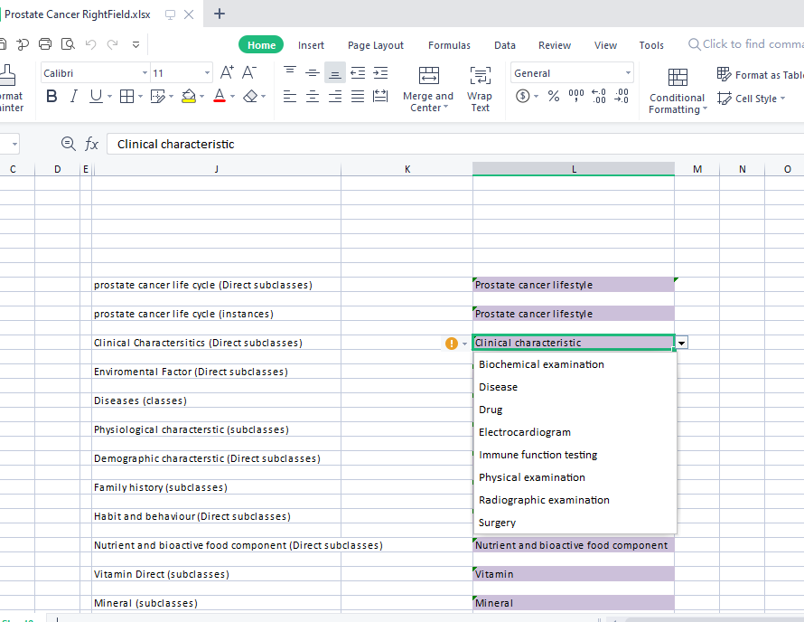
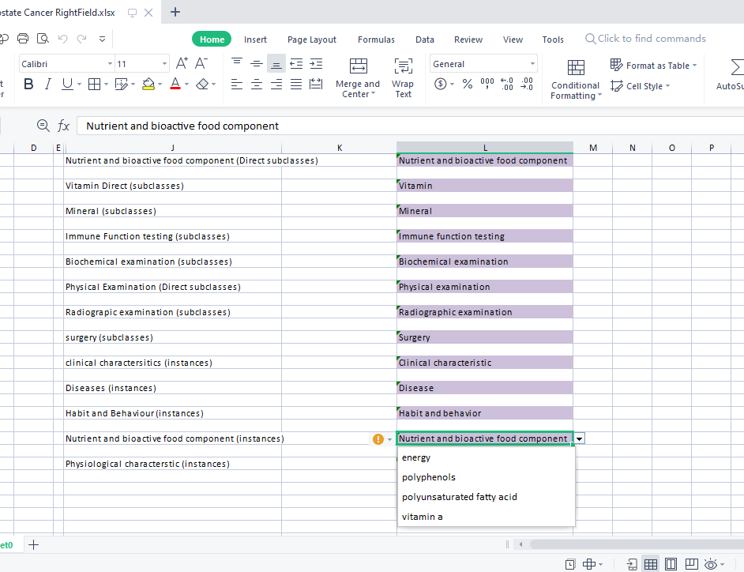
Clinical characteristic
Nutrient and bioactive
food component

